Slide 1
Interesting CNN properties (more visualizing and fooling deep networks) …slides and slide ideas from Marc'Aurelio Ranzato and Michael Nielson.
http://yosinski.com/deepvis

Slide 2
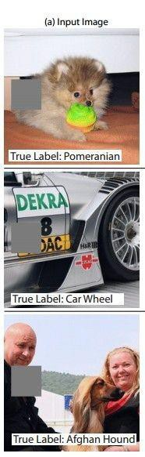
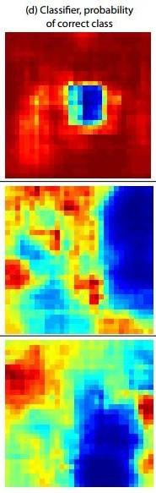
Occlusion experiments
(as a function of the position of the square of zeros in the original image)
[Zeiler & Fergus 2014]
Andrej Karpathy

Slide 3
Occlusion experiments
(as a function of the position of the square of zeros in the original image)
[Zeiler & Fergus 2014]
Andrej Karpathy

Slide 4
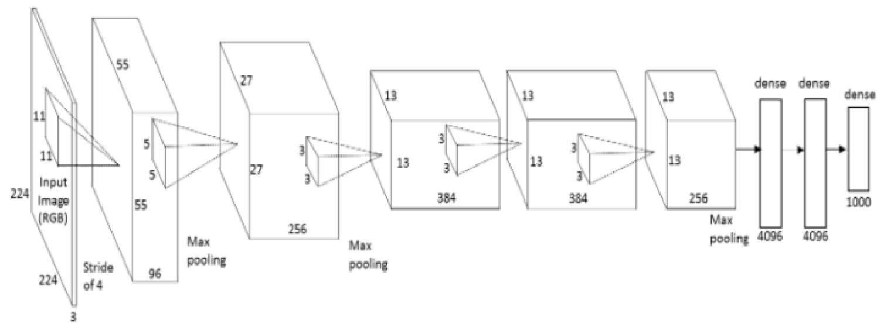
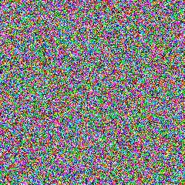
What input to a neuron maximizes a class score?
To visualize the function of a specific unit in a neural network, we synthesize an input to that unit which causes high activation.
Neuron of choice i
An image of random noise x.
Repeat:
Forward propagate: compute activation a_{i}(x)
Back propagate: compute gradient at neuron ∂a_{i}(x) / ∂x
Add small amount of gradient back to noisy image.
Andrej Karpathy
Notes:
Activation = result of the convolution
Next, we do a forward pass using this image xx as input to the network to compute the activation ai(x)ai(x) caused by xx at some neuron ii somewhere in the middle of the network. Then we do a backward pass (performing backprop) to compute the gradient of ai(x)ai(x) with respect to earlier activations in the network. At the end of the backward pass we are left with the gradient ∂ai(x)/∂x∂ai(x)/∂x , or how to change the color of each pixel to increase the activation of neuron ii . We do exactly that by adding a little fraction αα of that gradient to the image:
x←x+α⋅∂ai(x)/∂x
We keep doing that repeatedly until we have an image x∗x∗ that causes high activation of the neuron in question.

Slide 5
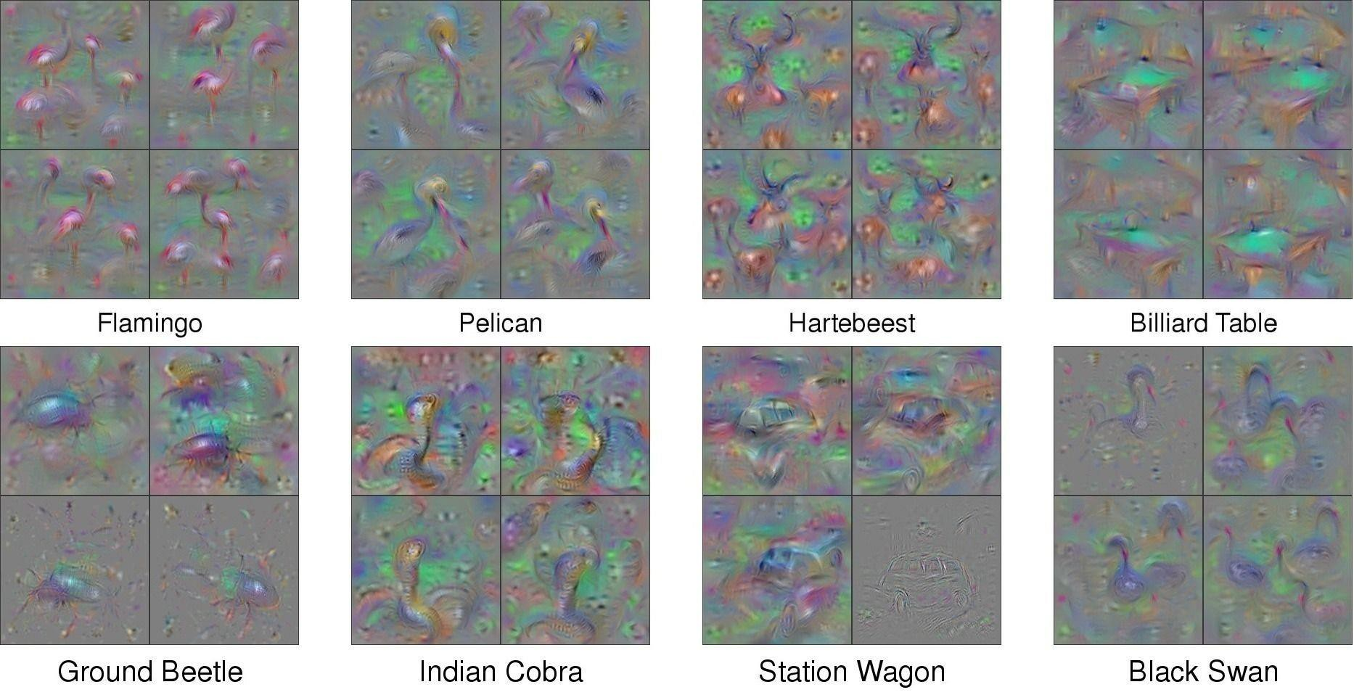
What image maximizes a class score?
[Understanding Neural Networks Through Deep Visualization, Yosinski et al. , 2015]
http://yosinski.com/deepvis
Andrej Karpathy

Slide 6
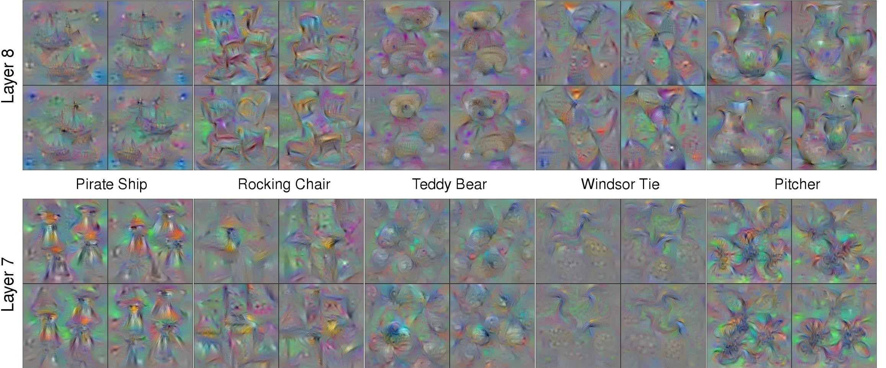
What image maximizes a class score?
Andrej Karpathy

Slide 7
Ok, what else can we optimize for in re-making an image?
Notes:
https://blog.keras.io/the-limitations-of-deep-learning.html

Slide 8
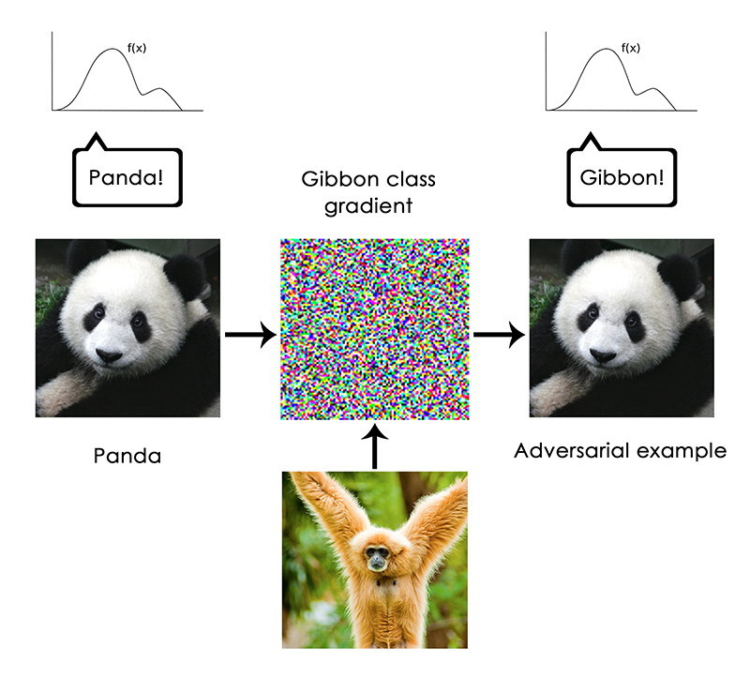
Francois Chollet - https://blog.keras.io/the-limitations-of-deep-learning.html
Notes:
But no

Slide 9
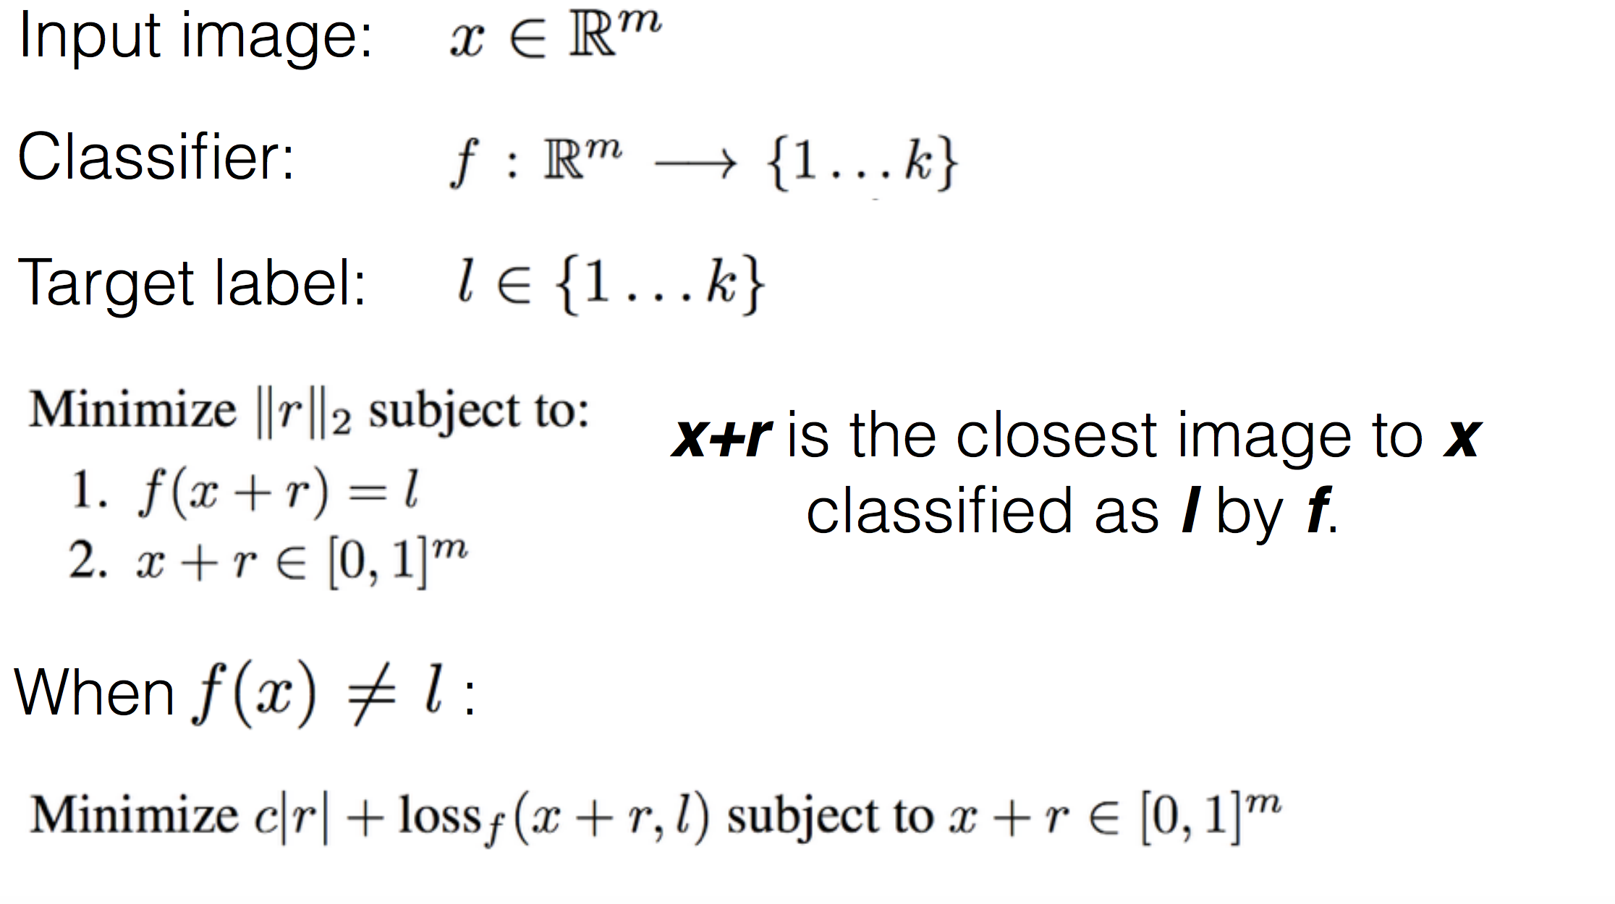
Generating Adversarial Examples
Notes:
Deep Neural
Networks learn input-output mappings that are
discontinuous to a significant extent.
L-BFGS an optmization algorithm like gradient descent

Slide 10
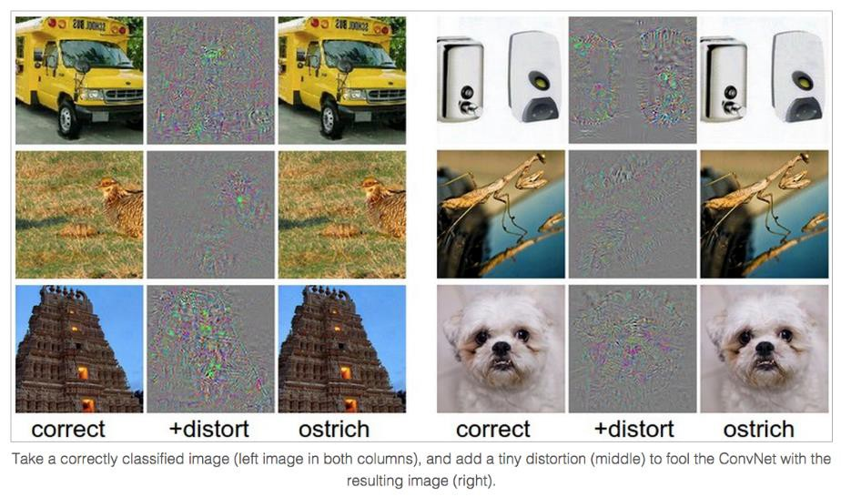
Breaking CNNs
Intriguing properties of neural networks [Szegedy ICLR 2014]
Andrej Karpathy

Slide 11
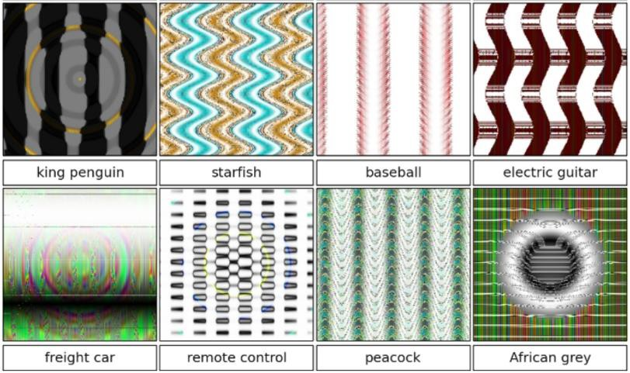
Breaking CNNs
Deep Neural Networks are Easily Fooled: High Confidence Predictions for Unrecognizable Images [Nguyen et al. CVPR 2015]
Jia-bin Huang
Notes:
But what types of images does this process produce? As we showed in a previous paper titled Deep networks are easily fooled: high confidence predictions for unrecognizable images, the results when this process is carried out on final-layer output neurons are images that the DNN thinks with near certainty are everyday objects, but that are completely unrecognizable as such.
Synthesizing images without regularization leads to “fooling images”: The DNN is near-certain all of these images are examples of the listed classes (over 99.6% certainty for the class listed under the image), but they are clearly not
http://www.cv-foundation.org/openaccess/content_cvpr_2015/papers/Nguyen_Deep_Neural_Networks_2015_CVPR_paper.pdf

Slide 12
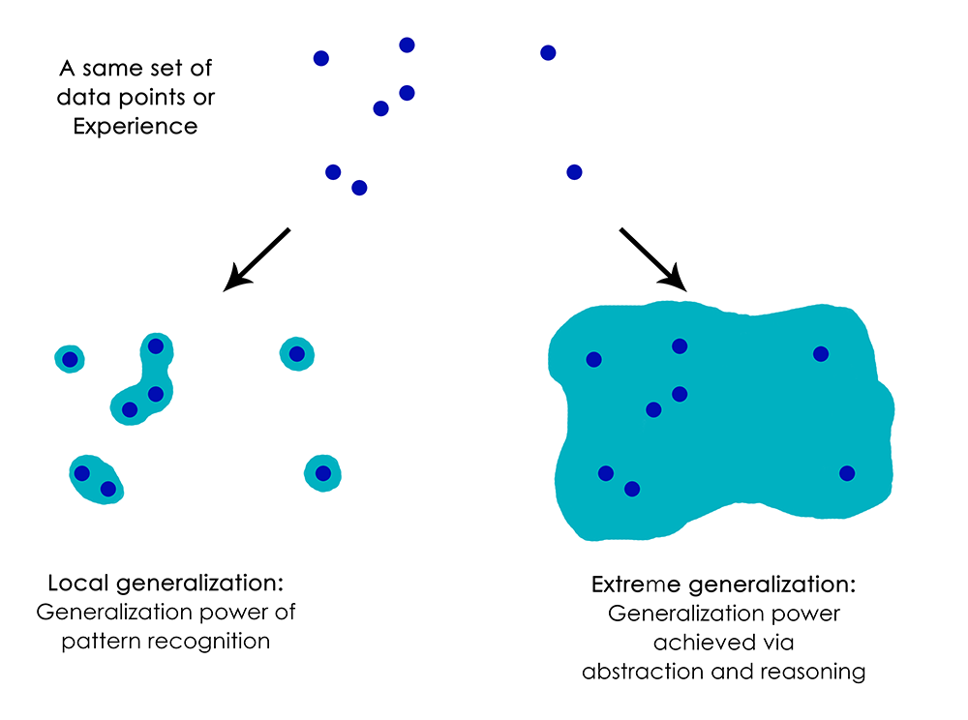
Francois Chollet - https://blog.keras.io/the-limitations-of-deep-learning.html
Notes:
Do not anthropormorphise what is going on! Is not a general intelligence that can abstract.

Slide 13
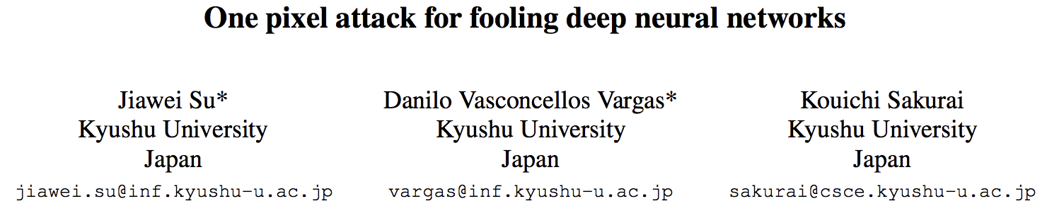

Slide 14
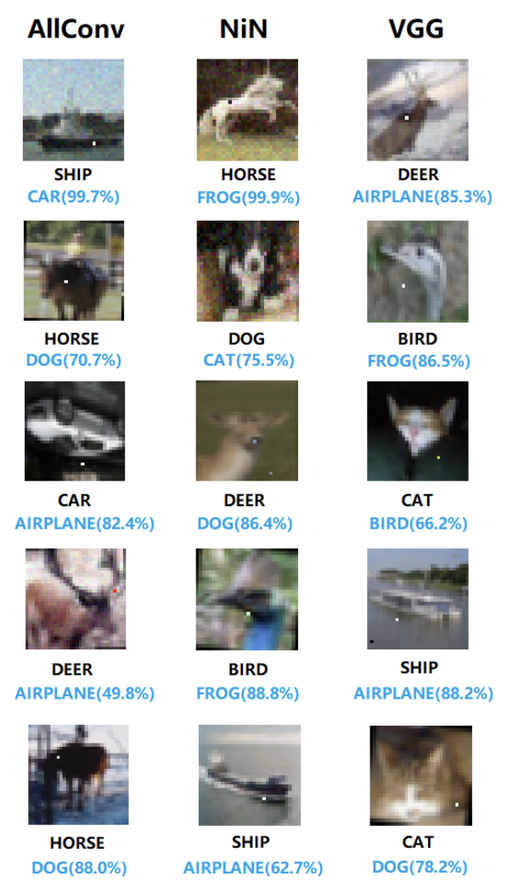
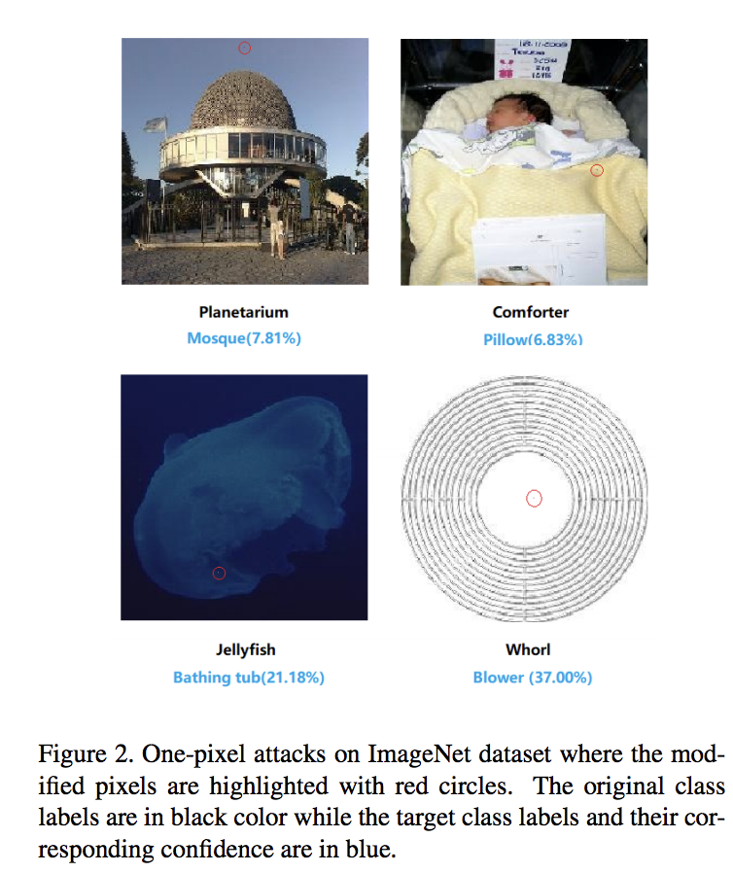

Slide 15
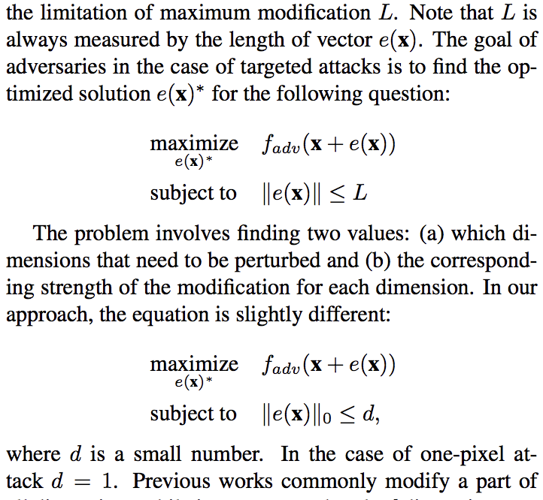

Slide 16
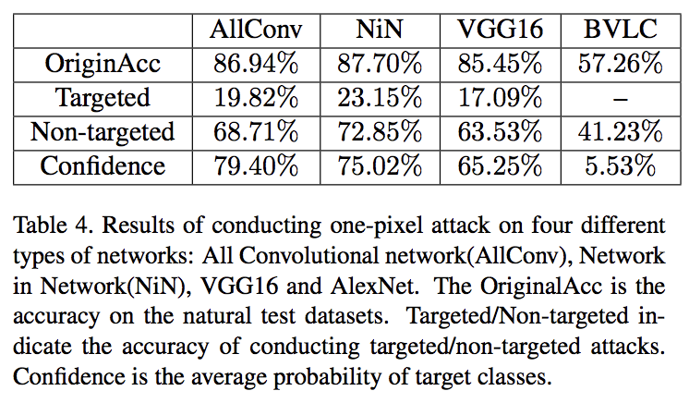

Slide 17
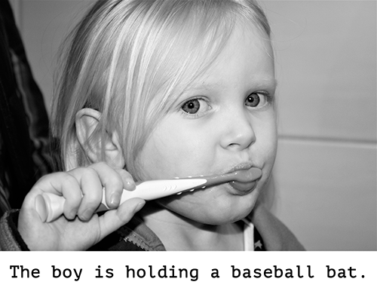
Francois Chollet - https://blog.keras.io/the-limitations-of-deep-learning.html

Slide 18
Reconstructing images
Question: Given a CNN code, is it possible to reconstruct the original image?
Andrej Karpathy

Slide 19
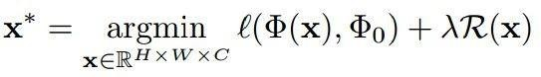
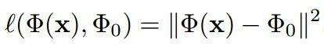
Reconstructing images
Find an image such that:
Its code is similar to a given code
It “looks natural”
Neighboring pixels should look similar
Image
Andrej Karpathy

Slide 20
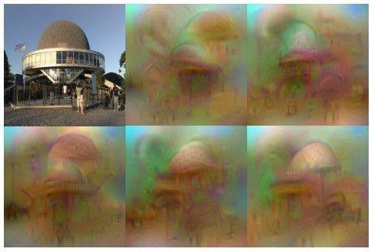
Reconstructing images
original image
Reconstructions from the 1000 log probabilities for ImageNet (ILSVRC)
classes
Understanding Deep Image Representations by Inverting Them
[Mahendran and Vedaldi, 2014]
Andrej Karpathy

Slide 21
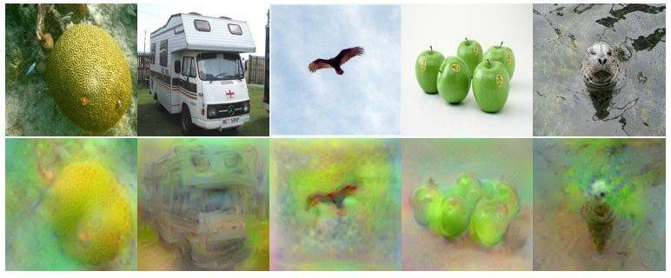
Reconstructing images
Reconstructions from the representation after last last pooling layer
(immediately before the first Fully Connected layer)
Andrej Karpathy

Slide 22
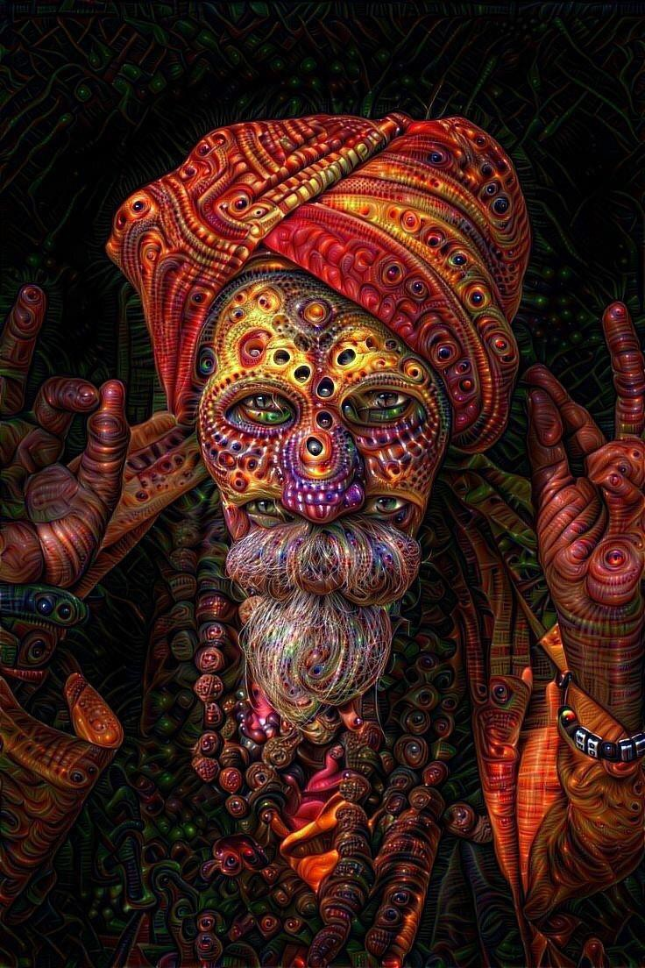
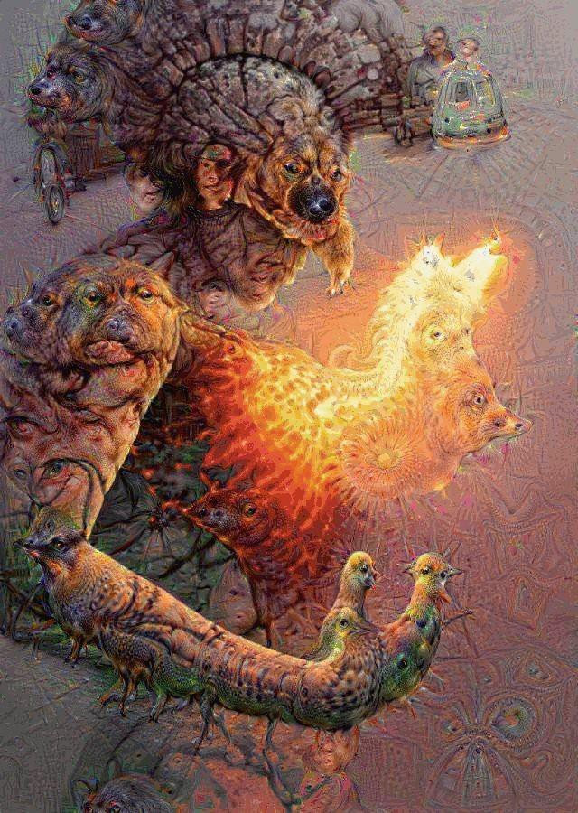
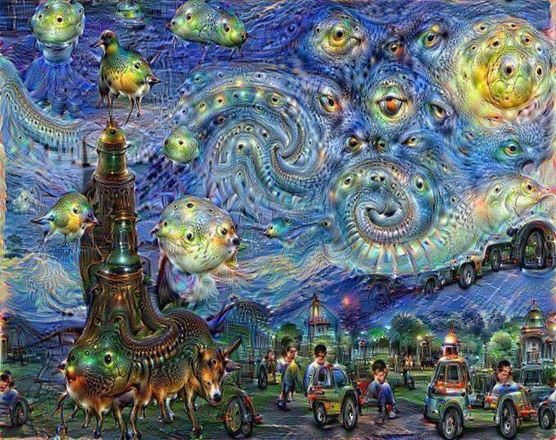
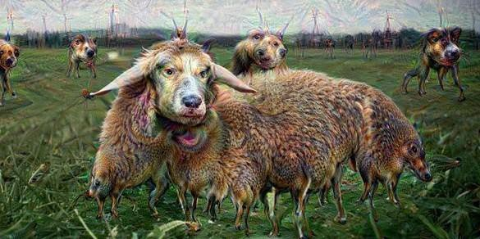
DeepDream
DeepDream https://github.com/google/deepdream
Andrej Karpathy

Slide 23
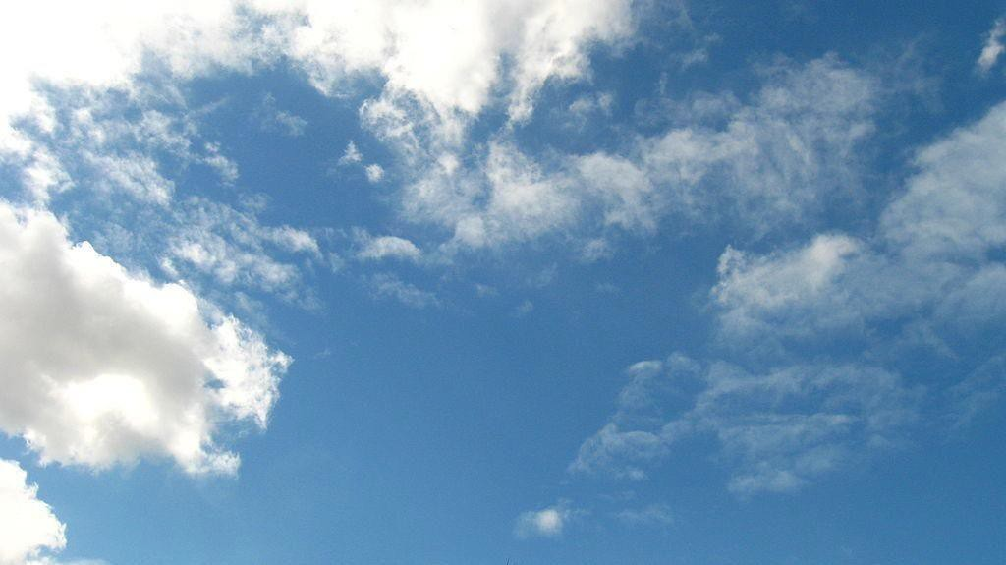
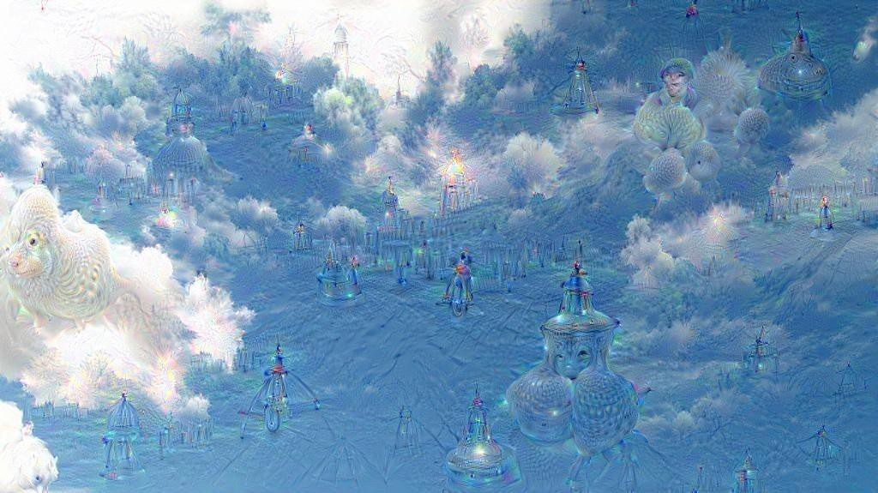
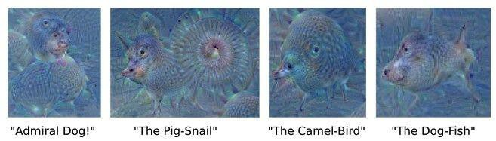
DeepDream
DeepDream modifies the image in a way that “boosts” all activations, at any layer
This creates a feedback loop: e.g., any slightly detected dog face will be made more and more dog-like over time.
Andrej Karpathy

Slide 24
DeepDream
Deep Dream Grocery Trip
https://www.youtube.com/watch?v=DgPaCWJL7XI
Deep Dreaming Fear & Loathing in Las Vegas: the Great San Francisco Acid Wave https://www.youtube.com/watch?v=oyxSerkkP4o
Andrej Karpathy

Slide 25
Style transfer

Slide 26
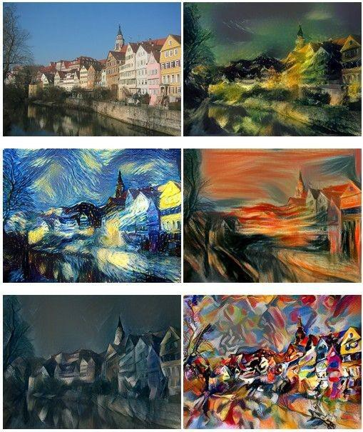
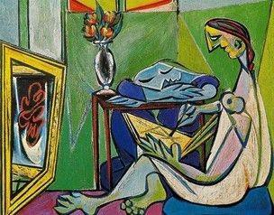
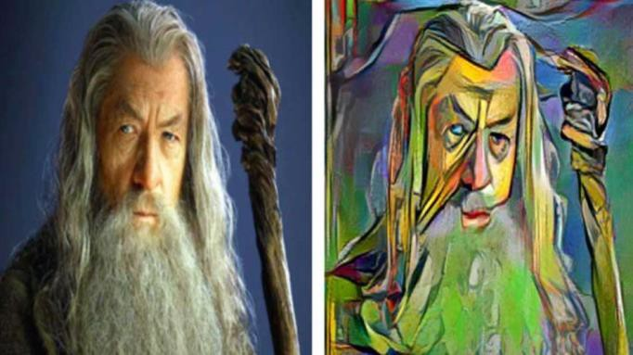
Neural Style
[ A Neural Algorithm of Artistic Style by Leon A. Gatys, Alexander S. Ecker, and Matthias Bethge, 2015] good implementation by Justin Johnson in Torch: https://github.com/jcjohnson/neural-style
Andrej Karpathy

Slide 27
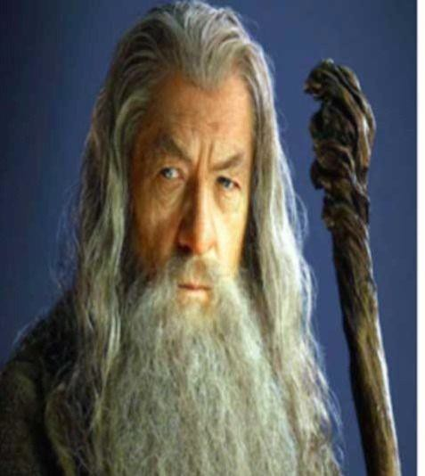
Neural Style
Step 1: Extract content targets (ConvNet activations of all layers for the given content image)
content activations
e.g.
at CONV5_1 layer we would have a [14x14x512] array of target activations
Andrej Karpathy

Slide 28
Neural Style
Step 2: Extract style targets (Gram matrices of ConvNet activations of all layers for the given style image)
style gram matrices
e.g.
at CONV1 layer (with [224x224x64] activations) would give a [64x64] Gram matrix of all pairwise activation covariances (summed across spatial locations)
Andrej Karpathy

Slide 29
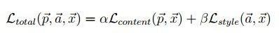
Neural Style
Step 3: Optimize over image to have:
The content of the content image (activations match content)
The style of the style image (Gram matrices of activations match style)
match content
match style
Adapted from Andrej Karpathy

Slide 30
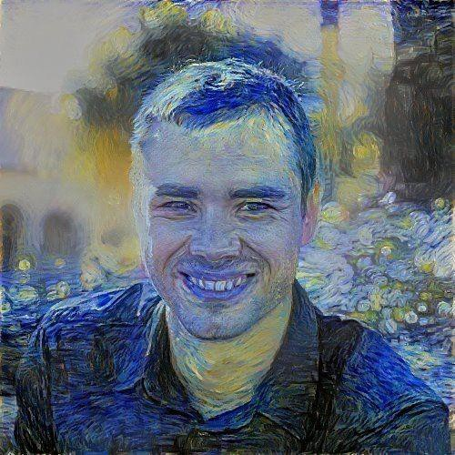
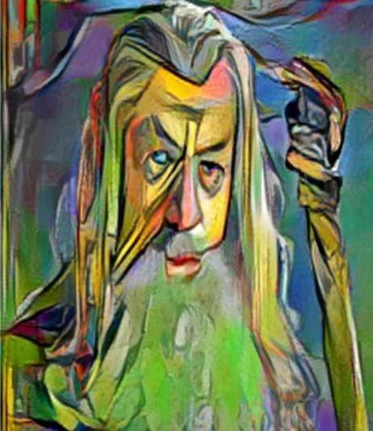
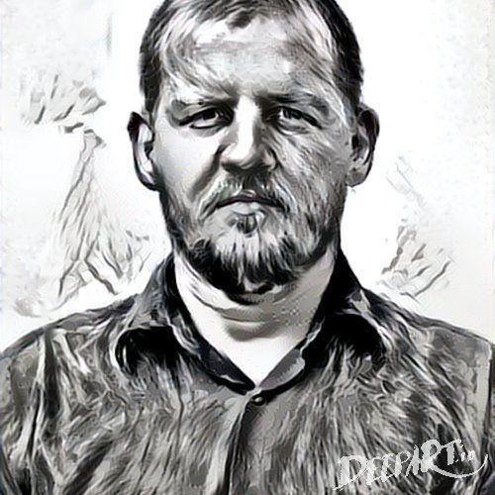
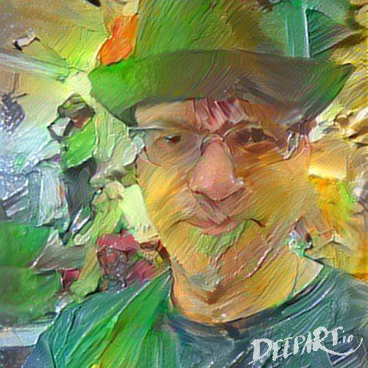
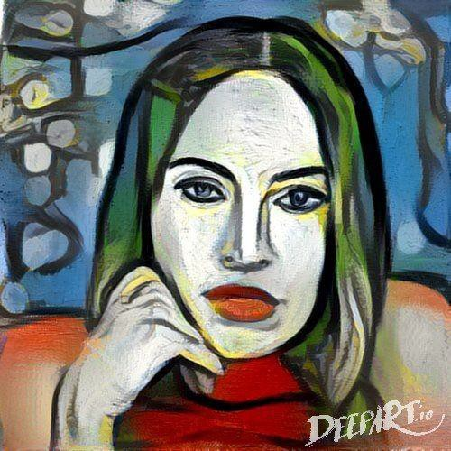
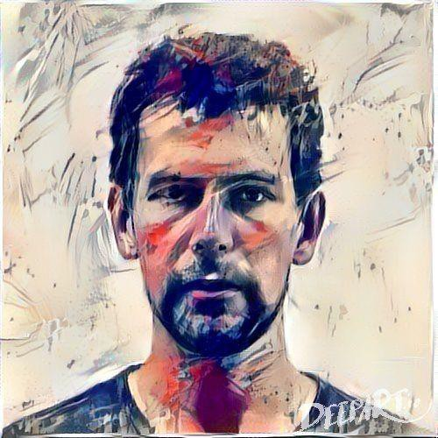
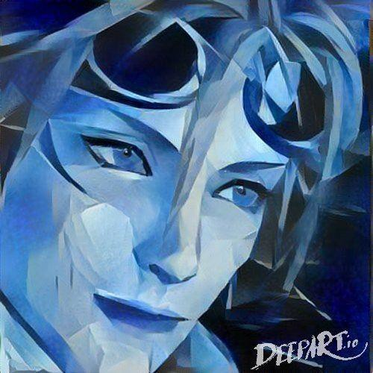
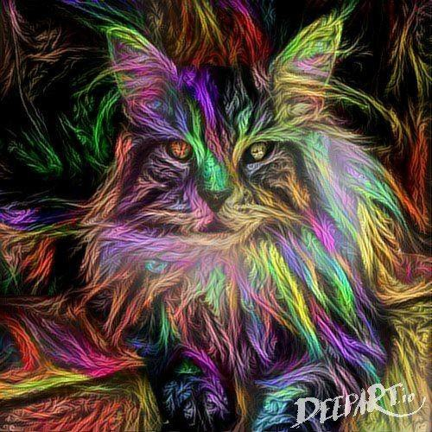
Neural Style
make your own easily on deepart.io
Andrej Karpathy

